Slide 1
SQL File Stream
Information processing techniques
Week 14
Murtaza Munawar fazal

Slide 2
CHARACTER(n) | Character string. Fixed-length n
char(n) | Fixed width character string. Maximum 8,000 characters
varchar(n) | Variable width character string. Maximum 8,000 characters
varchar(max) | Variable width character string. Maximum 1,073,741,824 characters
text | Variable width character string. Maximum 2GB of text data
nchar | Fixed width Unicode string. Maximum 4,000 characters
nvarchar | Variable width Unicode string. Maximum 4,000 characters
nvarchar(max) | Variable width Unicode string. Maximum 536,870,912 characters
ntext | Variable width Unicode string. Maximum 2GB of text data
bit | Allows 0, 1, or NULL
binary(n) | Fixed width binary string. Maximum 8,000 bytes
varbinary | Variable width binary string. Maximum 8,000 bytes
varbinary(max) | Variable width binary string. Maximum 2GB
image | Variable width binary string. Maximum 2GB
2
Notes:
Char , text , bit , binary, Image
Varchar, varbinary
Nchar, ntext, nvarchar,
Image to be depreciated

Slide 3
Types of Data
Structured
Semi-structured
Unstructured
3

Slide 4
Structured Data
“normal” RDBMS data
Format is known and defined
Example: Sales Order
4

Slide 5
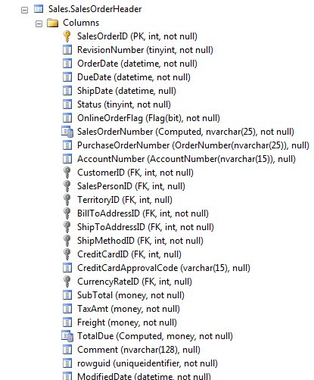

Slide 6
Semi Structured Data
some structure, but it is fluid
changes in structure should not break code
example: XML
6

Slide 7
Semi Structured Data
<SalesOrder DueDate=”20120201”>
<OrderID>12</OrderID>
<Customer>John Doe</Customer>
<OrderDate>2012/01/15</OrderDate>
<Items>
<Item>
<Product>Widget</Product>
<Quantity>12</Quantity>
</Item>
<Item>
<Product>Whatchamacallit</Product>
<Quantity>2</Quantity>
</Item>
</Items>
</SalesOrder>
7

Slide 8
Unstructured Data
structure is merely encoding.
meta data may be in the structure
examples:
Audio files
Word Documents
PDF
Movies
8

Slide 9
Unstructured Data - Pre 2008
In SQL Server large binary files handling had two solutions:
store in the file system, but a reference in the database
administrative issues (backup, security)
synchronization issues
store the binary file in the database
Text/image/varbinary data type
complex storage, manipulation, and retrieval.
9

Slide 10
Filestream
Added in SQL Server 2008
Allows storage in the filesystem, but appears to be in the database.

Slide 11
SQL Server Instance
Filegroup_1
File 1 - c:\Program Files\...\Data\MyDB.mdf
File 2 - c:\Program Files\...\Data\MyDB2.ndf
File 3 - c:\Program Files\...\Data\MyDB3.ndf
Table: MyMP3s
-----------------
Name varchar(200)
MP3 varbinary(max)

Slide 12
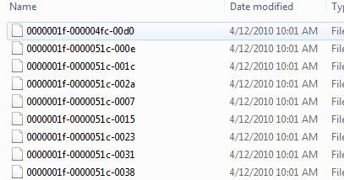
SQL Server Instance
Filegroup_1
File 1 - c:\Program Files\...\Data\MyDB.mdf
File 2 - c:\Program Files\...\Data\MyDB2.ndf
File 3 - c:\Program Files\...\Data\MyDB3.ndf
Table: MyMP3s
-----------------
Name varchar(200)
MyMP3 VARBINARY(MAX) FILESTREAM
Filegroup_2 - Filestream
File 1 - c:\Program Files\...\Data\FileStreamData

Slide 13
Filestream
Comparison point | Storage solution
 | File server / file system | SQL Server (using varbinary(max))
Maximum BLOB size | NTFS volume size | 2 GB – 1 bytes
Streaming performance of large BLOBs | Excellent | Poor
Security | Manual ACLs | Integrated
Cost per GB | Low | High
Manageability | Difficult | Integrated
Integration with structured data | Difficult | Data-level consistency
Application development and deployment | More complex | More simple
Recovery from data fragmentation | Excellent | Poor
Performance of frequent small updates | Excellent | Moderate

Slide 14
Filestream
Comparison point | Storage solution
 | File server / file system | SQL Server (using varbinary(max)) | FILESTREAM
Maximum BLOB size | NTFS volume size | 2 GB – 1 bytes | NTFS volume size
Streaming performance of large BLOBs | Excellent | Poor | Excellent
Security | Manual ACLs | Integrated | Integrated + automatic ACLs
Cost per GB | Low | High | Low
Manageability | Difficult | Integrated | Integrated
Integration with structured data | Difficult | Data-level consistency | Data-level consistency
Application development and deployment | More complex | More simple | More simple
Recovery from data fragmentation | Excellent | Poor | Excellent
Performance of frequent small updates | Excellent | Moderate | Poor

Slide 15
Filestream - Caveats
TDE does not encrypt filestream data
Encryption is not supported on Filestream data
Containers cannot be nested
In a cluster – filestream container must be on shared resources.

Slide 16
File Stream
Enabling the FILESTREAM feature for a given SQL Server instance
Setting the access level for the FILESTREAM data
Adding FILESTREAM storage to an existing database
Adding a FILESTREAM column to an existing table
Inserting BLOB data into the FILESTREAM column.

Slide 17
FILESTREAM is a hybrid feature that requires both the Windows Administrator and the SQL Server Administrator to perform actions before the feature is enabled. Because of this, the configuration is often a two-step process.
The Windows Administrator manages the Windows-related configuration changes needed for the FILESTREAM feature. For example, Windows Administrator privileges are required to create a Windows file share for the FILESTREAM feature. The Windows Administrator uses the SQL Server Configuration Manager to enable, disable, and configure FILESTREAM.
The SQL Server Administrator manages the configuration changes within the boundaries of the given SQL Server instance. The SQL Administrator enables, disables, and configures the FILESTREAM Access Level, either by using SQL Server Management Studio or by running sp_configure.

Slide 18
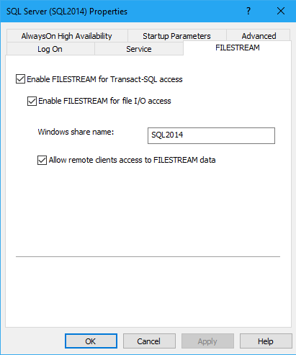
Enabling FILESTREAM
Our first step is to enable the FILESTREAM feature at the instance level. Briefly, on the machine on which the SQL Server 2008 instance is installed, navigate as follows (this path may change in future versions): Start | All Programs | Microsoft SQL Server 2008 | Configuration Tools | SQL Server Configuration Manager, then select SQL Server Services. Right-click on the appropriate instance, select Properties then move to the FILESTREAM tab. In here, you can enable the instance for T-SQL and file I/O streaming access.

Slide 19

Setting the access level
All the rest of the work can be done from within SQL Server Management Studio (SSMS), so open it up and connect to the instance you just FILESTREAM enabled. Since we are enabling FILESTREAM access on an instance that did not have FILESTREAM enabled as part of the SQL Server installation process, we will also need to set the FILESTREAM Access Level.

Slide 20
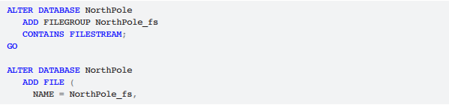
Adding FILESTREAM storage
Next, we need to add a FILESTREAM filegroup and FILESTREAM file (data container) to the database
Note that the C:\ArtOfFS\Demos\Chapter1 directory must exist on the appropriate SQL Server instance machine

Slide 21
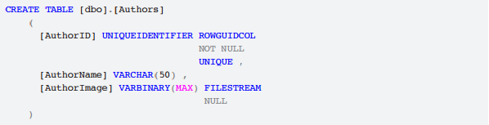
Adding a FILESTREAM column
A FILESTREAM column can be created only on a table that has a UNIQUEIDENTIFIER column with the ROWGUIDCOL attribute. Notice, also, that the table contains an AuthorImage column of type VARBINARY(MAX)to which we've applied the FILESTREAM attribute.

Slide 22
Size of the files
As per Microsoft Research paper, To BLOB or Not To BLOB:
For BLOBs that are smaller than 256 KB, the best performance will probably be obtained by simply storing the data directly in the relational tables.
Files larger than 1 MB are better stored in the file system, and managed through SQL Server using FILESTREAM.
In that in-between region of 256 KB to 1 MB, the decision of which way to go can only be taken after analyzing the specific data usage scenarios

Slide 23
Data usage patterns
FILESTREAM does not support in-place (also referred to as "partial") updates of BLOB data files. Instead, every time a BLOB value is modified, SQL Server creates an entirely new copy of the file with the modified content, and discards the old file. The old file will be deleted by an asynchronous garbage collector process.
If your business requirement includes making frequent changes to the BLOB data values, then FILESTREAM may not be the right option. However, this decision should be taken only after running some tests with the expected usage pattern and deciding whether to go with FILESTREAM or VARBINARY(MAX) storage.

Slide 24
Writing File to Database Using File Stream
Insert into the desired table with the File Content as empty
Get File Path from SQL File Stream
comm.CommandText = string.Format(@"SELECT TOP(1) FileContent.PathName() FROM <table> WHERE <condition>");
string path = comm.ExecuteScalar().ToString();
Write Byte Stream Data to Memory Stream
MemoryStream FileContent = new MemoryStream();
BinaryWriter writer = new BinaryWriter(FileContent);
writer.Write(BinaryData);

Slide 25
Write data from Memory Stream to SQL (File Stream)
Get SQL Write Destination:
comm.CommandText = string.Format(@"SELECT TOP(1) GET_FILESTREAM_TRANSACTION_CONTEXT() FROM <table> where <condition>");
byte[] transactionContext = (byte[])comm.ExecuteScalar();
Write to Database
System.Data.SqlTypes.SqlFileStream destination = new System.Data.SqlTypes.SqlFileStream(path,transactionContext, System.IO.FileAccess.Write);
FileContent.CopyTo(destination);

Slide 26
References
FILESTREAM Overview - http://msdn.microsoft.com/en-us/library/bb933993.aspx
FILESTREAM Best Practices –http://msdn.microsoft.com/en-us/library/dd206979.aspx
FILESTREAM Storage in SQL Server 2008 - http://msdn.microsoft.com/en-us/library/cc949109.aspx
Remote BLOB store - http://technet.microsoft.com/en-us/library/gg638709.aspx
Enable the Prerequisites for FileTable - http://msdn.microsoft.com/en-us/library/gg509097(v=sql.110).aspx
Create, Alter, and Drop FileTables - http://msdn.microsoft.com/en-us/library/gg509088%28v=sql.110%29.aspx

